Slide 1




AI and Machine Learning Foundations
ETL vs ELT
Neural Networks
NLP
Vector Embeddings

Slide 2
Python's Role in AI Systems
Why Python for AI?
Readable syntax & fast iteration speed
Massive ML ecosystem: TensorFlow, PyTorch, scikit-learn, Hugging Face, LangChain
Most AI research published with Python code
Real-World Examples
Google DeepMind & OpenAI GPT: Python for training, data pipelines & inference APIs
JP Morgan fraud detection: feature engineering, model training & REST API — all Python
Python AI Stack
scikit-learn — Classical ML algorithms
PyTorch / TensorFlow — Deep learning frameworks
Hugging Face — Pre-trained LLMs
LangChain — LLM application framework
FastAPI — ML model serving
Entry Point
run_all.py — runs the full Day 1 pipeline end to end
Project folder: day1-ai-foundations/

Slide 3
Java to Python Transfer
Dynamic vs Static Types
Java: statically typed — types checked at compile time
Python: dynamically typed — types checked at runtime
Type hints (x: int = 5) are optional — Pydantic enforces them
OOP — Python Classes vs Java
def __init__(self) instead of a constructor
No public/private — underscore _foo = "treat as private"
Django, LangChain, scikit-learn — all built on Python OOP
Exceptions in Python
try/except/finally (not try/catch/finally like Java)
Unchecked — no "throws" declaration on methods
Pydantic raises ValidationError automatically — FastAPI returns 422
Key Comparisons
Java: public double predict(List<Double> features)
Python: def predict(features: list[float]) -> float
Java: @Service public class ModelService { }
Python: class ModelService: — no annotation needed

Slide 4
Python Dataclasses for Plain Data
@dataclass
Auto-generates __init__, __repr__, __eq__
Equivalent to Java Lombok @Data or Java 16+ records
5 lines instead of 20 lines of boilerplate
@dataclass(frozen=True)
Immutable after creation — like Java record or Lombok @Value
Use for value objects: GPS coords, currency pairs, ML hyperparameters
field(default_factory=list)
Never use enrolled: list = [] — shared across all instances!
field(default_factory=list) creates a new list per instance
5 Dataclass Examples (models.py)
Student — basic mutable dataclass
Coordinate — frozen=True (immutable)
Course — default_factory for list fields
MLExperiment — __post_init__ for validation
DataPoint/Dataset — nested dataclasses (composition)
Real-World Usage
Apache Airflow uses dataclasses for DAG task metadata
Databricks ML pipelines use dataclasses for experiment runs

Slide 5
Type Hints as a Design Tool
What Are Type Hints?
PEP 484: annotate variables, function params & return types
Python does NOT enforce them at runtime — they are documentation
Tools that check them: mypy, Pylance, Pydantic
Key Type Annotations
int, str, float, bool
list[str], dict[str, int], tuple[int, ...]
Optional[float] — can be None
str | float — Union syntax (Python 3.10+)
Real-World Impact
Netflix: def get_recommendations(user_id: int, limit: int = 10) -> list[str]
FastAPI: type hints on params ARE the API schema — auto-generates OpenAPI docs
Code Reference (models.py)
str | float in PredictionResponse.prediction — Union syntax
list[str] = field(default_factory=list) — generics in dataclass
Optional[float] in ModelMetrics — nullable fields
Key Rule
Type hints = documentation for humans & tools; Pydantic = enforcement at runtime

Slide 6
Pydantic v2: Structured Data Validation
BaseModel
Reads type hints and ACTUALLY enforces them at runtime
Coerces where possible ("42" → 42); raises ValidationError if it cannot
FastAPI: validates every request body; returns 422 automatically
@field_validator
Custom validation on a single field after type coercion
e.g., validate algorithm name against an allowed whitelist
@model_validator
Cross-field validation: runs after ALL fields are populated (e.g., date range checks)
Pydantic Settings (BaseSettings)
Reads config from environment variables automatically
12-factor app config: different values in dev/staging/prod without code changes
export APP_LOG_LEVEL=DEBUG — AppSettings reads it with env_prefix="APP_"
Pydantic Models in models.py
TrainingRequest — validates model_name, algorithm, Field(ge=0.1, le=0.5)
ModelMetrics — optional float fields with bounds
DatasetStats — @model_validator for cross-field distribution check

Slide 7
uv: Modern Python Package Manager
What is uv?
Drop-in replacement for pip + virtualenv written in Rust
10-100x faster than pip: parallel downloads + lockfile (uv.lock)
Reads pyproject.toml (modern standard replacing setup.py & requirements.txt)
One tool: venv creation, package install, dependency resolution, script running
Key Commands
uv venv --python 3.12 & source .venv/bin/activate
uv pip install -e . (install project + all deps)
uv run pytest tests/ -v (run tests inside the venv)
Real-World Example
Bank CI/CD pipeline: package install step dropped from 4 minutes to 15 seconds with uv
Consultancy data team: uv.lock guarantees every analyst gets identical package versions — no "works on my machine" bugs
Project Files
pyproject.toml — project name, requires-python = ">=3.12", all dependencies, pytest config
.python-version — single line "3.12", tells uv which Python to use
vs pip + virtualenv
pip has no lockfile by default; uv generates uv.lock automatically for reproducibility
uv reads Python version from .python-version; pip requires manual management

Slide 8



AI vs ML vs Deep Learning
AI
Machines mimicking human cognitive functions like problem-solving and learning.
ML
Subset of AI where systems learn from data without explicit programming.
Deep Learning
Subset of ML using multi-layered neural networks to learn patterns from data.
ML
Machine Learning
AI
DL
Artificial Intelligence
Deep Learning

Slide 9






Supervised vs Unsupervised Learning
Supervised Learning
Definition: Training with labeled data (input-output pairs)
Data Requirements: Labeled dataset with input-output pairs
Human Intervention: High (requires labeled data)
Applications: Classification, regression, object detection
Unsupervised Learning
Definition: Finding patterns in unlabeled data
Data Requirements: Unlabeled data only
Human Intervention: Medium (cluster interpretation)
Applications: Clustering, dimensionality reduction, anomaly detection
Classification
Regression
Object Detection
Clustering
Dimensionality Reduction
Anomaly Detection
Semi-supervised Learning
Definition: Combination using both labeled and unlabeled data
Approach: Leverages labeled data for guidance while utilizing unlabeled data to improve generalization
Self-supervised Learning
Definition: Creating labels from the data itself
Approach: Designs auxiliary tasks to learn representations without human-labeled data
Key Difference: Supervised learning requires labeled data and clear outputs, while unsupervised learning discovers hidden patterns in unlabeled data.

Slide 10
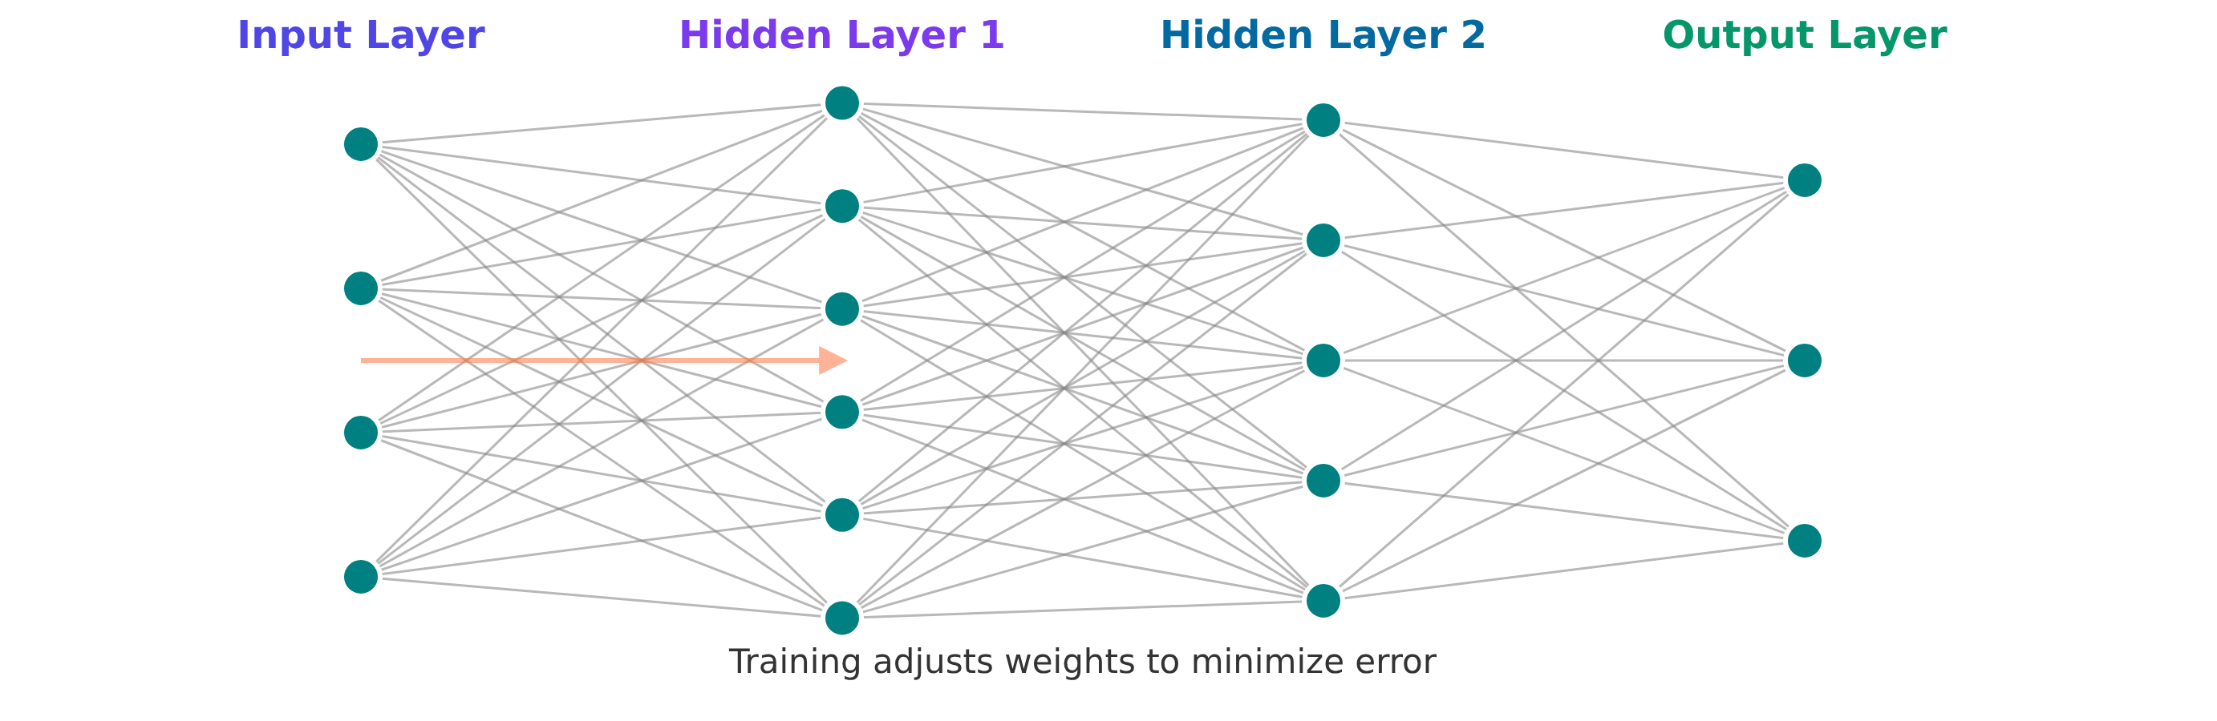
Neural Networks Basics
Biological Inspiration
Neural networks are inspired by the human brain
Components
Neurons (nodes), layers, weights, and biases
Layer Types
Input: Receives data
Hidden: Transforms inputs
Output: Produces predictions
Forward Propagation
Signal flows from input to output
Backpropagation
Adjusts weights based on error
Training Process
Uses gradient descent and optimization

Slide 11
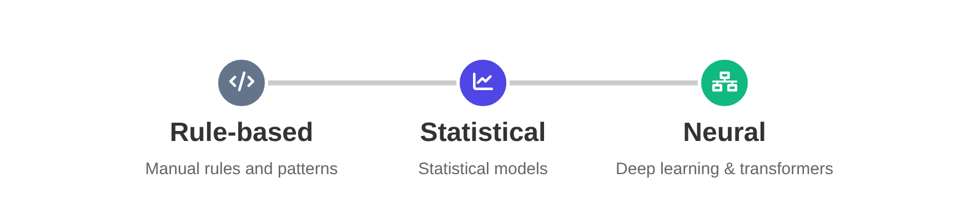
NLP Fundamentals
Natural Language Processing (NLP) enables computers to understand, interpret, and generate human language, bridging the gap between human communication and computer comprehension.
Key Challenges
Ambiguity: Words with multiple meanings
Context-dependence: Meaning varies by context
Evolving language: New words and usage patterns
Semantic complexity: Understanding implied meanings
Core Tasks
Text classification: Categorizing text content
Named entity recognition: Identifying people, places, organizations
Sentiment analysis: Determining emotional tone
Dependency parsing: Analyzing grammatical structure
Applications
Machine translation: Converting text between languages
Chatbots: Conversational agents
Text summarization: Condensing content
Question answering: Providing answers to questions
NLP Evolution
Rule-based → Statistical → Neural (Transformer-based)
Modern NLP
Transformer architecture: Revolutionized NLP
BERT: Bidirectional understanding
GPT: Generative capabilities
Multimodal processing: Text + images + audio + video

Slide 12
Tokenization
Tokenization is the process of breaking down text into smaller units called tokens. These tokens can be words, subwords, or even characters.
Word-level
Splitting on spaces and punctuation.
AI is powerful
Simple and intuitive
Subword-level
Breaking words into meaningful pieces (BPE, WordPiece).
AI is power ful
Handles rare words
Character-level
Individual characters as tokens.
A I i s
Simple for any language
Special Tokens
[CLS] Marks start of sequence
[SEP] Separates sequences
Challenges
Different languages with varying structure
Emojis and special characters
Rare words and out-of-vocabulary items
Impact on vocabulary size and model performance

Slide 13

Word Embeddings (Word2Vec, GloVe)
Word2Vec (2013)
Definition: Predictive model learning word relationships based on context
CBOW: Predicts target word from context
Skip-gram: Predicts context words from target
Strengths: Efficient for large datasets
GloVe (2014)
Definition: Global co-occurrence statistics approach
Approach: Constructs global co-occurrence matrix
Learning: Learns from overall co-occurrence
Strengths: Balances local and global statistics
Key Properties
Similar words have similar vector representations
Captures semantic relationships and analogies
king - man + woman ≈ queen (vector arithmetic)
Pre-trained models available for common languages
Limitations
Static representations (context ignored)
Word ambiguity not fully resolved
Requires large datasets for training
Computational complexity for large vocabularies

Slide 14

Semantic Similarity
Definition
Measuring relatedness between words, sentences, or documents based on meaning.
Applications
Search: Improving relevance beyond keyword matching
Recommendations: Suggesting related content
Duplicate detection: Finding similar content
Types
Word-level: Similarity between individual words
Document-level: Similarity between documents
Evaluation Metrics
Human judgment correlation: Matching human expectations
Precision@k: Proportion of relevant results in top k
Implementation
Embedding vectors: Comparing positions in vector space
Contextual similarity: Using context-aware embeddings

Slide 15

Cosine Similarity
Definition
Measure of similarity between two non-zero vectors in an inner product space.
It calculates the cosine of the angle between two vectors.
Visualization
Formula
cos(θ) = (A·B)/(||A||·||B||)
A·B: Dot product of vectors A and B
||A||: Magnitude of vector A
||B||: Magnitude of vector B
Advantages
Normalized for vector length
Efficient computation
Focuses on orientation, not magnitude
Limitations
Doesn't account for magnitude differences
May not capture semantic nuances
Sensitive to high-dimensional sparse vectors
Range
1: Identical vectors (angle = 0°)
0: Orthogonal vectors (angle = 90°)
-1: Opposite vectors (angle = 180°)

Slide 16
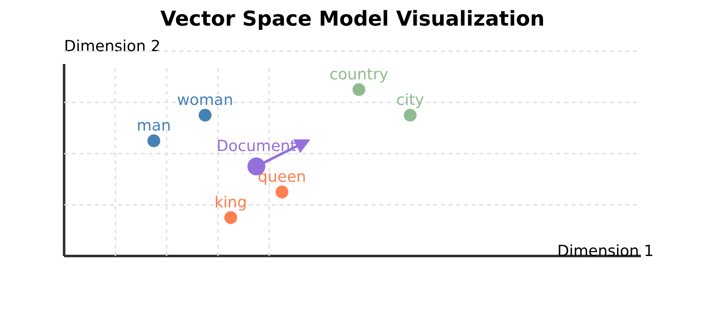
Vector Space Model
Definition
A mathematical model that represents text as points in multi-dimensional space, where each dimension corresponds to a term or feature.
Document Representation
Documents represented as vectors
Word vectors aggregated into document vectors
Similarity measured by distance between vectors
Approaches
Traditional
Bag-of-words
TF-IDF
Modern
Dense embeddings
Contextual representations
Dimensionality
Trade-off between expressiveness and efficiency. Higher dimensions capture more nuances but require more computational resources.
Visualization Techniques
PCA for linear dimensionality reduction
t-SNE for non-linear visualization

Slide 17

ML Workflow
Data Collection
Gathering relevant data from various sources.
Preprocessing
Cleaning, normalization, and feature engineering.
Splitting
Dividing data into training, validation, and test sets.
Model Selection
Choosing appropriate algorithms for the problem.
Training
Optimizing model parameters on training data.
Hyperparameter Tuning
Optimizing model parameters using various methods.
Evaluation
Selecting metrics to evaluate model performance.
Deployment
Serving models in production environments.
Monitoring
Tracking performance and detecting concept drift.

Slide 18
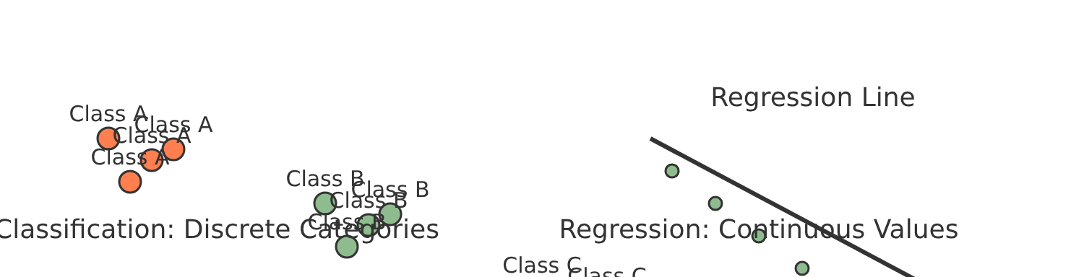
Classification vs Regression
Classification
Definition: Predicting discrete categories
Types:
Binary: Two classes (spam/not spam)
Multi-class: Multiple exclusive classes
Multi-label: Multiple non-exclusive classes
Metrics:
Accuracy
Precision
Recall
F1-score
AUC-ROC
Regression
Definition: Predicting continuous numerical values
Types:
Linear: Straight-line relationships
Polynomial: Curved relationships
Logistic: S-shaped curves
Metrics:
MSE (Mean Squared Error)
MAE (Mean Absolute Error)
R-squared
RMSE (Root Mean Squared Error)
Visualization
Key Differences
Difference
Output Type
Evaluation
Loss Function
Classification
Discrete categories
Accuracy, precision
Log-loss
Regression
Continuous values
MSE, MAE
Squared error

